Slide 1
LO: To recognise some common conductors and insulators;
To use selection within a program
Context: Make and program a device that checks the conductivity of an object

Slide 2

Today we’re going to link science and computing.
We’ll use our knowledge and understanding of:
  Electricity
  Conductors/insulators
  Programming
Make and program a device, using the Crumble, to check whether a material is a conductor/insulator

Slide 3

What do we already know about electrical conductors and insulators?

Slide 4
How can we test if an object is a conductor/insulator?
What knowledge can we use to help us?

Slide 5
We are going to use the Crumble to create a device which can detect if an object is a conductor/insulator
By using the Sparkle as an output (to show us information) how could we do this?

Slide 6

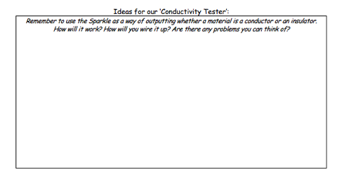
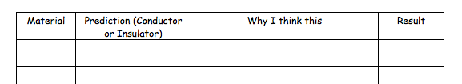
1. Work in your group to discuss and plan your idea
2. List some materials you would like to test, then predict whether you think they’ll be conductors/insulators, and why!

Slide 7
Make your conductivity tester!
You can check to see if your tester is working, by touching the two croc leads (that would connect to your material) together.
To simulate an insulator, leave the two leads disconnected.

Slide 8
Make your conductivity tester
Hints: You can check to see if your tester is working, by touching the two croc leads (that would connect to your material) together. To simulate an insulator, leave the two leads disconnected.
Extension: Use a switch to start the conductivity testor
Greater Depth:
Some materials are better conductors than other. By taking the analogue input on the Crumble, we can see how conductive a material is. Use a Sparkle Baton to produce a conductivity scale

Slide 9
Time to test!
Work through testing your materials on your conductivity testers.

Slide 10

Plenary:
Discuss with your group, and then other groups. Were there any materials that surprised you?

Slide 11


This work is licensed under the Creative Commons Attribution-ShareAlike 4.0 International License. To view a copy of this license, visit https://creativecommons.org/licenses/by-sa/4.0/. For permissions or attribution contact: www.redfernelectronics.co.uk or www.mindsetsonline.co.uk

