Slide 1
LO: To use selection within a program
Context: Scanner Bot

Slide 2

Scanner Bots
Today we’re going to be using the Crumble to detect intruders

Slide 3

This is an Ultrasonic Distance Sensor
Who knows/can remember/can guess what this does?

Slide 4

The field of view of the Ultrasonic is quite narrow.
How can we improve this/see all around?

Slide 5
What will this code do?
Have a think about this piece of code. What does it do?

Slide 6
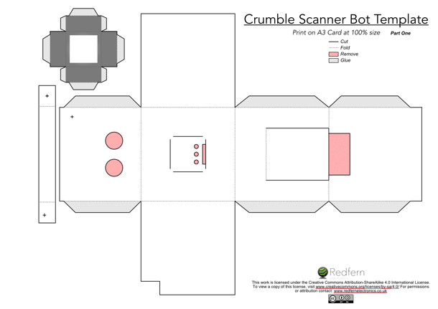
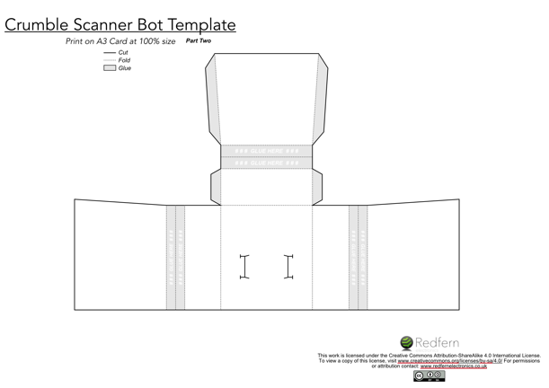
Make the Scanner Bot Body
*Move to where appropriate*
If using the template, cut, fold and glue it together to make your Scanner Bot.

Slide 7

Scanner Bot Time!
Work towards the following:
Motor turns continuously
Motor turns with Sparkle lit
Motor stops when the Ultrasonic detects an object that is too close; Sparkle changes colour.
Flash the Sparkle whilst the motor is stopped.
Final Criteria:
Scanner Bot will turn, with the Sparkle lit
It will stop when it detects an object, and flash its Sparkle
It will continue turning when the object ‘leaves’.
Greater Depth Extension:
Use the Servo to open and close the mouth.
Make the Scanner Bot turn in a random direction each time.

Slide 8

Plenary:
How well did you meet the Scanner Bot criteria?
Final Criteria:
Scanner Bot will turn, with the Sparkle lit
It will stop when it detects an object, and flash its Sparkle
It will continue turning when the object ‘leaves’.
Can anyone think of an extension to this project?
How else could we use the components from this project e.g. the Ultrasonic?

Slide 9

This work is licensed under the Creative Commons Attribution-ShareAlike 4.0 International License. To view a copy of this license, visit www.creativecommons.org/licenses/by-sa/4.0/ For permissions or attribution contact: www.redfernelectronics.co.uk

