Slide 1
LO: To use repetition to control physical outputs
Context: Police Lights.

Slide 2

Has anyone seen a police car when it’s rushing to an emergency?
Why are the lights so important?
Can anyone describe how the lights flash?

Slide 3
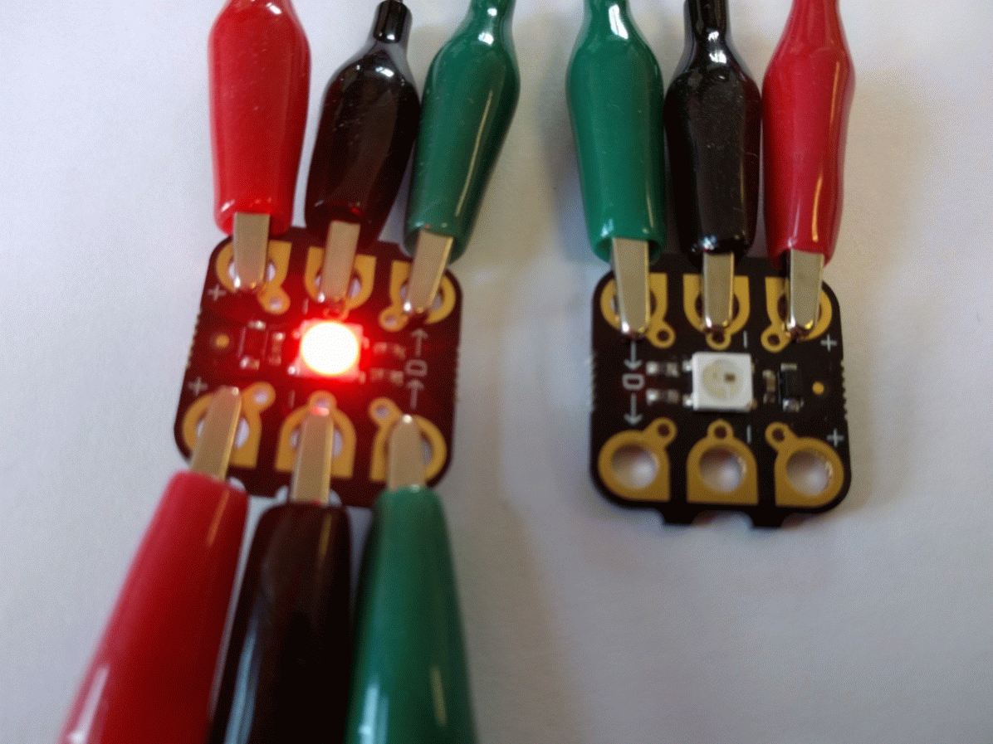

What would the algorithm be for this pattern of lights?


Slide 4

Police light algorithm:


Slide 5
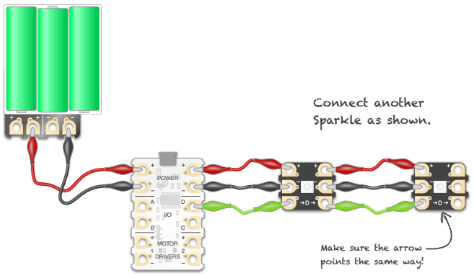
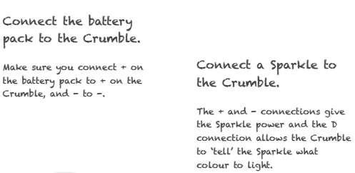
Set up your crumble like this:


Slide 6
How could we program the police lights on the Crumble?


Slide 7
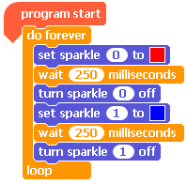
Example Code:


Slide 8
After you have your lights working, change the ‘waits’ to see what happens.


Slide 9
Can you create your own sequence of lights?

Extension – use a nested loop to make your program shorter and more efficient.
Greater depth – Start a new blank project. Can you make a flashing pattern that repeats two different light sequences?

Slide 10
Plenary:

Go around the class and look at everyone’s projects. Is their code different from yours? Why?
How could we add another challenge to this project?
How could you use this code within another project?

Slide 11
Police Car Model

Decorate the template how you want.
Carefully cut the template out.
Add glue to the tabs and stick it together.
Fix your lights to the inside of the model.

Slide 12


This work is licensed under the Creative Commons Attribution-NonCommercial-ShareAlike 4.0 International License. To view a copy of this license, visit http://creativecommons.org/licenses/by-nc-sa/4.0/ . For permissions or attribution contact: www.redfernelectronics.co.uk or www.mindsetsonline.co.uk

