Slide 1
LO: To use an input to control an output
Context: Light House

Slide 2

What is this?

What is it for?

Slide 3
How does a lighthouse work?

A lighthouse is similar to a telescope, but works in exactly the opposite way—with the help of a Fresnel lens.
The glass lenses in a telescope refract (bend) light rays from distant objects so they seem to be much nearer. But in a lighthouse, the Fresnel lens wrapped around the lamp concentrates the light rays into a powerful and parallel beam so people can see it, with just a naked eye, as far as 30 km (about 20 miles) away or more!
This is possible because:
Lighthouses use amazingly powerful xenon lamps (a little bit like neon lamps) that are hundreds of thousands of times brighter than the lamps in your home.
They mount their lamps in towers high above the sea level, which makes them visible roughly five times further away.
They use specially shaped lenses and prisms to concentrate their light into a super-powerful beam.
Adapted from: http://www.explainthatstuff.com/fresnel-lenses.html

Slide 4
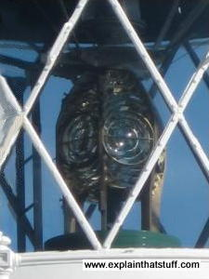
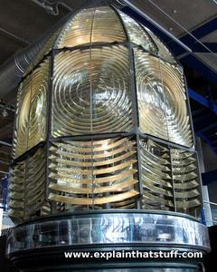
How does a lighthouse work?

Some lights just flash:
Whereas in others, the lens rotates. This makes the light appear to flash.
Adapted from: http://www.explainthatstuff.com/fresnel-lenses.html

Slide 5

You can see the light beams in this photo:


Slide 6
Set up the Crumble

You need to have one Sparkle flashing once every two seconds.

Slide 7

Imagine that you are at sea in a boat, and you can see a lighthouse…
If it is day time, it would be quite easy to tell which lighthouse it is and where you are.
But what if it was dark?
How do you think a lighthouse can ‘let people know’ which one it is?

Slide 8

Lighthouses have a distinct pattern for their light.
Sailors can time the flashes and work out which lighthouse it is.
Even today, if a boat’s navigation system stops working, sailors will still look at lighthouses to work out where they are.

Slide 9
Can you program the light sequence that you’re given?


Slide 10

It used to be the case that lighthouses would have to me manually turned on (old ones would need to be lit!).
What do we need to be able to turn our light sequence on or off?

Slide 11
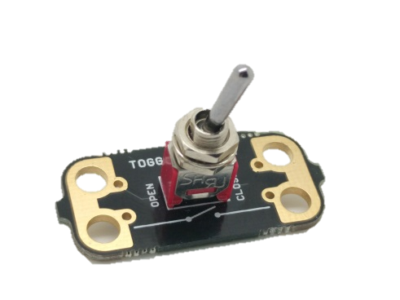
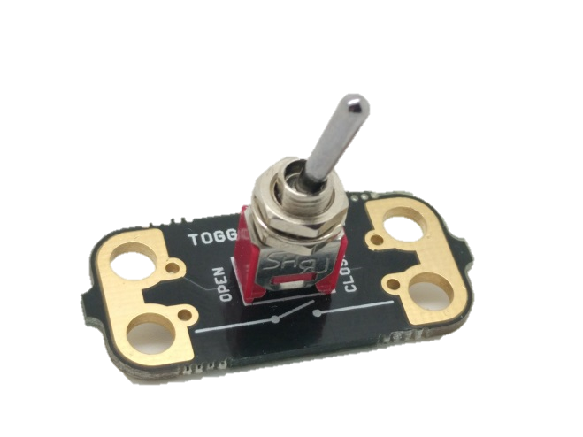
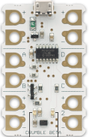
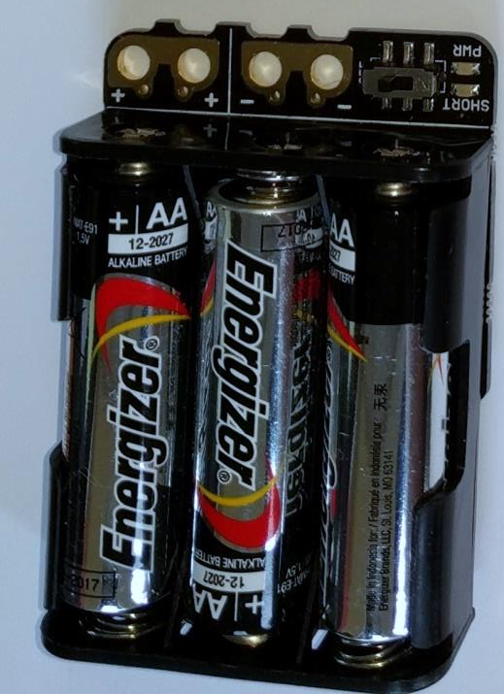
Toggle Switch

Toggle switches are easy to set up. Connect one side to the + on the battery pack, and the other side to A,B or C.
When the switch is closed (on) electricity can flow through to the input (A).

Slide 12

What is the algorithm for turning our light sequence on using a toggle switch?


Slide 13


Can you adapt your previous program, so that when the toggle switch is closed, your light sequence will run (flash) ?

Slide 14
Plenary:

Go around the class and look at everyone’s projects. Is their code different from yours? Why?
Look at who used an LDR. How did they do it?
How could you use this code within another project?

Slide 15
Build your lighthouse to put your electronics into


Slide 16


This work is licensed under the Creative Commons Attribution-NonCommercial-ShareAlike 4.0 International License. To view a copy of this license, visit http://creativecommons.org/licenses/by-nc-sa/4.0/ . For permissions or attribution contact: www.redfernelectronics.co.uk or www.mindsetsonline.co.uk

