Slide 1
LO: To use sequence, selection and repetition
Context: Countdown Clock

Slide 2

What is this for?

How long is it?
How many degrees does the second hand turn

Slide 3
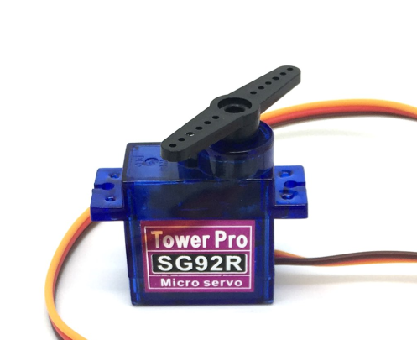

We are going to be making our own countdown clocks, using a servo.

A servo has a 180 degree range of movement.
The servo control block accepts a number from -90 to 90

Slide 4
In 30 seconds, the hand needs to move 180 degrees. How many degrees does the hand need to move each second?
How would we do this with the Crumble?


Slide 5
Using the Crumble, create a Countdown style clock that lasts for 30 seconds.

Try and use a loop, not a long list of instructions!

Slide 6
It would be useful to be able to make the clock start at the push of a button.
It would also be good to reset it when finished without using the power button.


Slide 7
Can you add in a push-to-make switch?

The switch needs to start the countdown.
The switch also must reset the timer when finished.
Greater Depth – Can you add a buzzer into your project? Can you make it beep quicker when the time has nearly finished?

Slide 8
Make your clock to put everything into.


Slide 9
Plenary:

Have a look at everyone’s projects. Are they different? Why?
How could you improve your project?
How could you use what you’ve learnt today in a future project?

Slide 10


This work is licensed under the Creative Commons Attribution-NonCommercial-ShareAlike 4.0 International License. To view a copy of this license, visit http://creativecommons.org/licenses/by-nc-sa/4.0/ . For permissions or attribution contact: www.redfernelectronics.co.uk or www.mindsetsonline.co.uk

