Slide 1
LO: To use an input to control an output
Context: Probability Spinner

Slide 2
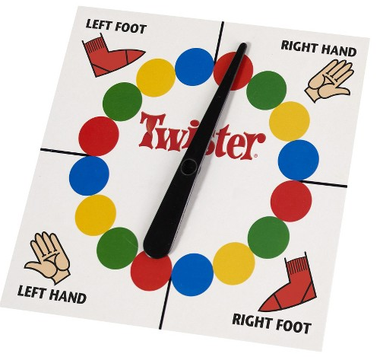
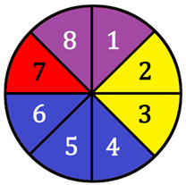
What are these?

What do they do?
What is the chance of getting each colour?
Spinner picture location
Twister image location

Slide 3

You will be using a motor to make your own probability spinners.
What would the algorithm for a spinner look like?


Slide 4


Can you create the Crumble program to spin your spinner (motor) for a random amount of time?


Slide 5
It would be useful to start the spinner at the push of a button!

Discuss with a partner how you could do this.

Slide 6
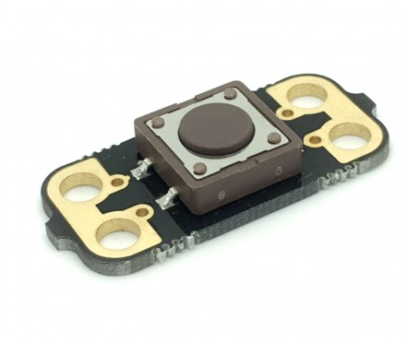
Add the push-to-make switch into your project.

Greater Depth- can you make your spinner more realistic?
Hint: they slow down gradually!

Slide 7
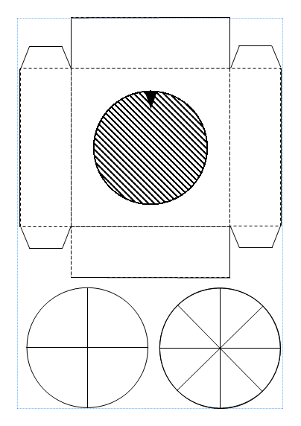
Make your spinner


Slide 8
Plenary:

Have a go with your spinner:
    In pairs, start at 30 and take it in turn to spin your spinner, subtracting the outcome each time. First to 0 wins!
How could you have improved your project?
How could you use what you’ve learnt today in a project in the future?

Slide 9


This work is licensed under the Creative Commons Attribution-NonCommercial-ShareAlike 4.0 International License. To view a copy of this license, visit http://creativecommons.org/licenses/by-nc-sa/4.0/ . For permissions or attribution contact: www.redfernelectronics.co.uk or www.mindsetsonline.co.uk

