Slide 1
LO: To use selection to control an output
Context: Parking sensor

Slide 2
How many of you have been in a car that starts beeping when you get too close to an object? (reversing)


Slide 3

What are they called?
What are they for? What else do you know about them?

Slide 4
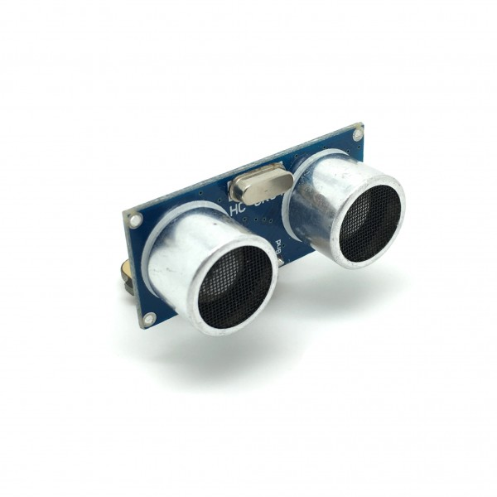
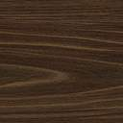

Ultrasonic distance sensor

= 30cm

Slide 5

What would the algorithm be to turn all the Sparkles to green, when an object is closer than 120cm?


Slide 6
Write the code which turns the Sparkles green when an object is closer than 120cm.

120cm

Slide 7
Parking sensors usually have a ‘beep’ as well, to let you know when the object is closer.
How could we add that?


Slide 8

Add in the beeping buzzer.

120cm

Slide 9


Greater Depth – Parking sensors normally have different stages, depending on how close to the object you are.
Can you use the following for your improved parking sensors:
120cm
80cm
30cm

Slide 10
Plenary:

Have a look at each other’s sensors and code:
    Have they solved it in a different way?
What other uses can you think of for the ultrasonic distance sensor?

Slide 11


This work is licensed under the Creative Commons Attribution-NonCommercial-ShareAlike 4.0 International License. To view a copy of this license, visit http://creativecommons.org/licenses/by-nc-sa/4.0/ . For permissions or attribution contact: www.redfernelectronics.co.uk or www.mindsetsonline.co.uk

