Slide 1
LO: To use selection and variables within a program
Context: Reaction Timer

Slide 2

Reaction

Slide 3
Reaction:

-is a response to a situation or event.
Our bodies can react quite quickly to events, and to put this to the test we are going to create a reaction timer game.

Slide 4
Using the Crumble, Sparkles and a switch, how could we make a reaction timer?


Slide 5
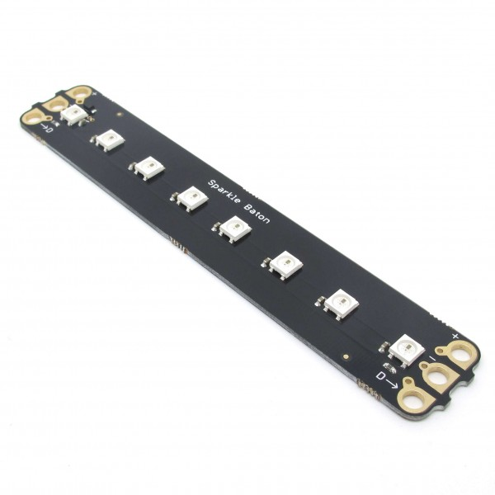
Reaction Timer:

Can you create a program that lights the Sparkles in sequence, with a 100ms delay between each.
There must be a random delay of 1-10s beforehand.
When the switch is pressed, the game resets.

Slide 6
It would be really good to show the player their score after they have pressed the button down…

How could we do this?

Slide 7
Now you need to show the player’s score afterwards.

E.g. Lighting Sparkles 0-7 gets a flashing blue Sparkle in the relevant place, or any longer and the whole baton flashes red.
Greater Depth – Can you add in a score-based countdown before the next game starts?
(Sparkles sequentially go to 0, starting at the player’s score)

Slide 8
Plenary:

Have a go at you peers’ reaction timers. Are they different? Why/why not?
How could you take the game further?
How could you use what you’ve learnt today in a future project?

Slide 9


This work is licensed under the Creative Commons Attribution-NonCommercial-ShareAlike 4.0 International License. To view a copy of this license, visit http://creativecommons.org/licenses/by-nc-sa/4.0/ . For permissions or attribution contact: www.redfernelectronics.co.uk or www.mindsetsonline.co.uk

