Slide 1
LO: To use an input to control an output
Context: Pumpkin

Slide 2
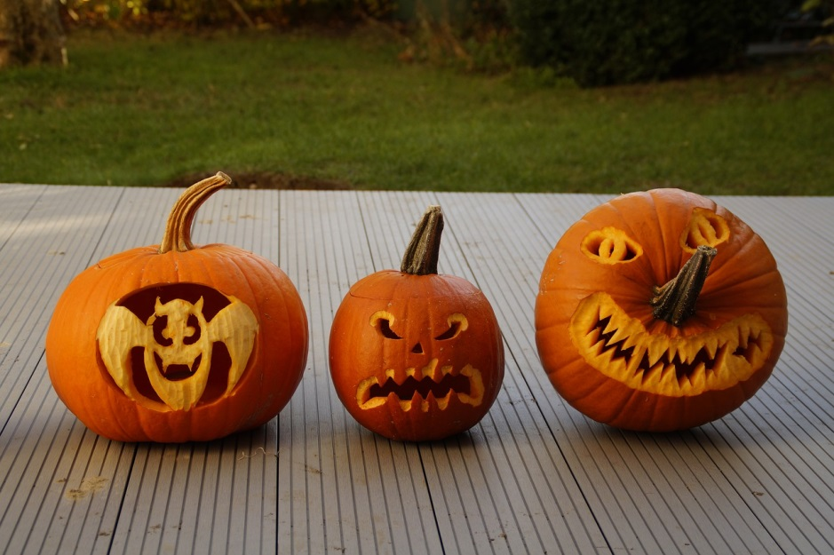
What makes us able to see these in the dark?


Slide 3
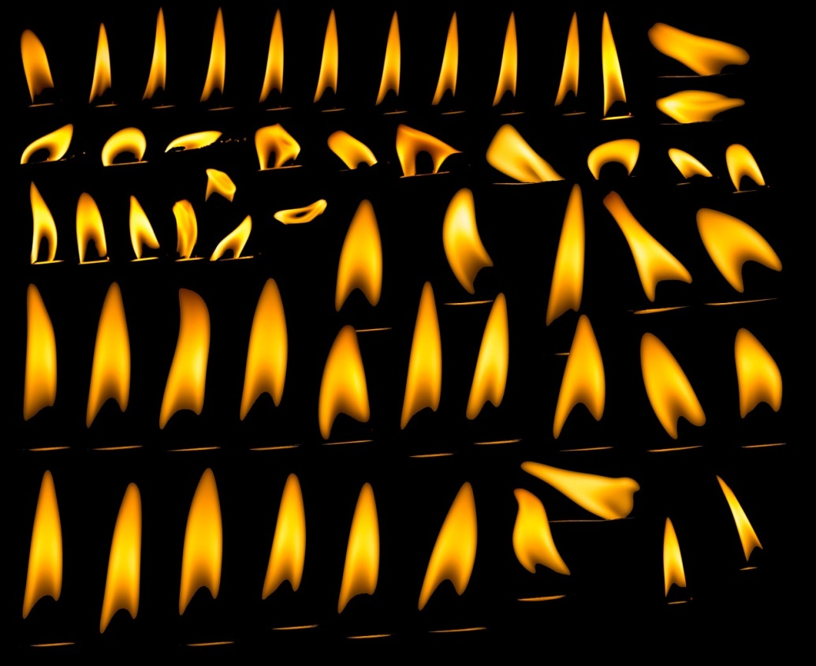
Is candlelight constant?
Does it vary?


Slide 4

Candlelight often ‘flickers’ – it becomes dimmer and brighter, and varies in colour.

What would the algorithm for this be?

Slide 5
Set up your Crumble and Sparkles.

Create a program to replicate a flickering candle.

Slide 6
Next Steps.

We need to be able to turn the Sparkle on and off when we want. We are going to add in a push-to-make switch.
How would you do this?

Slide 7
Add in a push switch that turns on the flickering Sparkle, and then turns it off again.

Greater Depth: How could you make the Sparkle automatic?
Hint: use an LDR

Slide 8

How to make a pumpkin…


Slide 9

Make your pumpkin!


Slide 10
Plenary:

Compare your pumpkins. Does anybody else have a candle effect that you prefer? Discuss the differences.
How could you use what you’ve learnt today in a future project?
How could we use an LDR to make the project automatic?

Slide 11


This work is licensed under the Creative Commons Attribution-NonCommercial-ShareAlike 4.0 International License. To view a copy of this license, visit http://creativecommons.org/licenses/by-nc-sa/4.0/ . For permissions or attribution contact: www.redfernelectronics.co.uk or www.mindsetsonline.co.uk

