Slide 1

LO: To design and program a room of a ‘Haunted House.’
Context: Haunted House

Slide 2
We are all going to be working collaboratively (together).

You are going to put into practise all of the work programming/Crumble work we have been doing.
By…

Slide 3
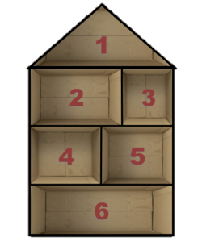
…designing and making a class haunted house.

You will be working in groups to design the room(box) of the haunted house.

Slide 4

Your room needs to:
  be animated and/or interactive;
  use the Crumble and different Crumbs(components);
  look nice!

Slide 5
Discuss your initial thoughts and ideas…


Slide 6
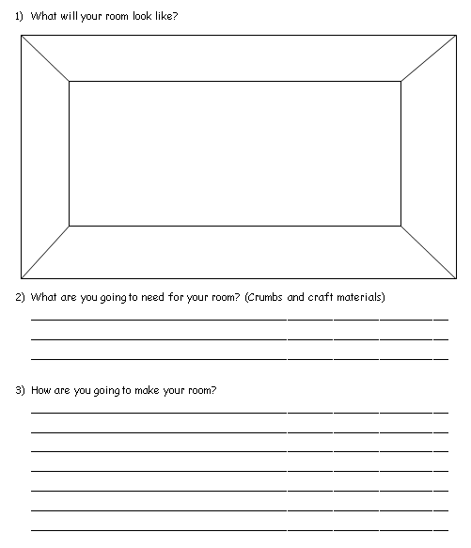
Complete sections 1-3


Slide 7
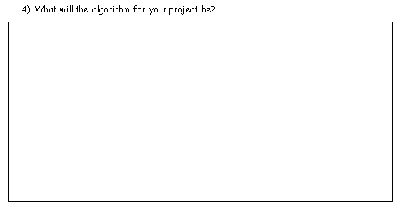
Now you’ve planned your room, you need to think about ‘how’ it’s going to work.

Discuss and write down your algorithm in section 4.

Slide 8
Let’s get started…


Slide 9
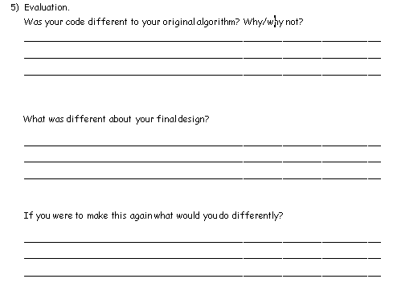
Now you need to complete the evaluation section (5).


Slide 10
Plenary:

Build the house!
Have a look at everyone else’s work.
Discuss: ‘If you were to make this again, what would you do differently?’

Slide 11


This work is licensed under the Creative Commons Attribution-NonCommercial-ShareAlike 4.0 International License. To view a copy of this license, visit http://creativecommons.org/licenses/by-nc-sa/4.0/ . For permissions or attribution contact: www.redfernelectronics.co.uk or www.mindsetsonline.co.uk

