Slide 1

LO: To use an input to control a mechanism
Context: Flapping Angel

Slide 2

Show children the angel.

Slide 3


Discuss the following questions:
How does the angel work?
What would the algorithm to control it be?

Slide 4

Program your Crumble to ’run the algorithm’.

Slide 5
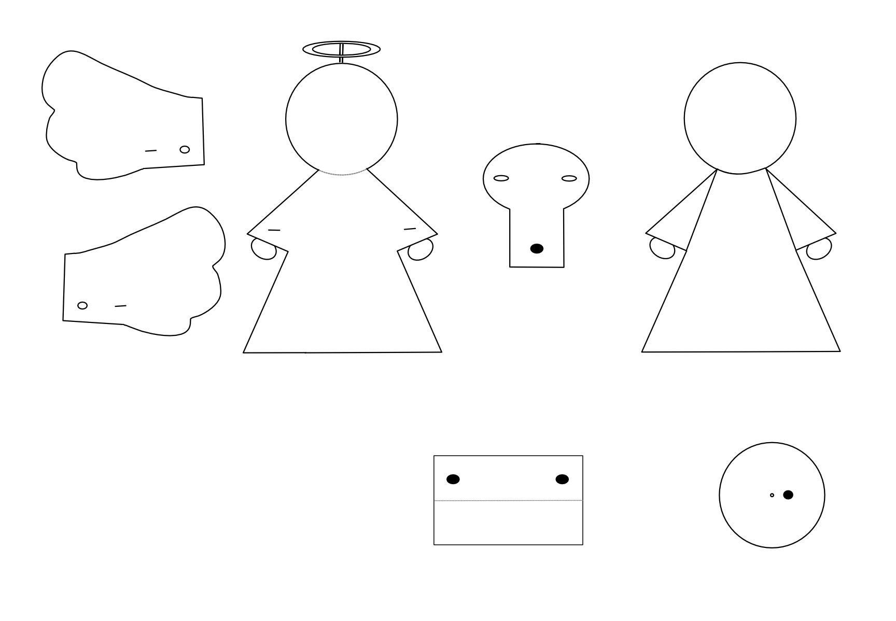
Now we are going to make our angels…

Slide 6
We want to control our angel with a switch.
What would the algorithm for this be?

Slide 7
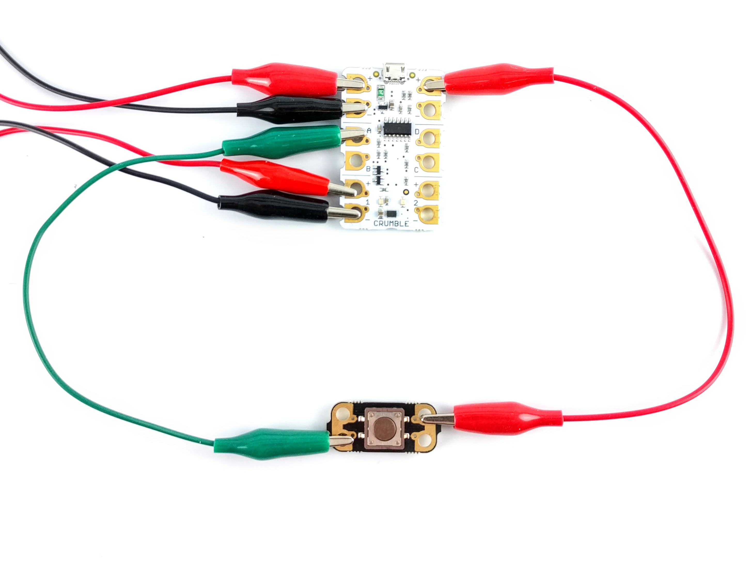
Program your angel to start flapping when you push the switch and then stop when you press it again.
Hint: this may be useful →
Greater Depth: Can you use an LDR to control your angel?
e.g. it starts flapping when you are closer than 20cm.

Slide 8

Plenary:
Look at your peers programs. Were they different/ the same? Why do you think that is?
GD: Show how you got your ultrasonic distance sensor to work.
How could the principals of this project (think about the mechanism) be useful in other projects?

Slide 9


This work is licensed under the Creative Commons Attribution-NonCommercial-ShareAlike 4.0 International License. To view a copy of this license, visit http://creativecommons.org/licenses/by-nc-sa/4.0/ . For permissions or attribution contact: www.redfernelectronics.co.uk or www.mindsetsonline.co.uk

