Slide 1

LO: To use variables to control an output
Context: Spinning Santa

Slide 2

What is a variable?
Variable

Slide 3

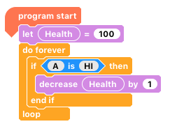
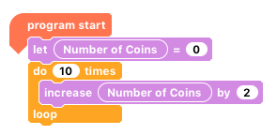
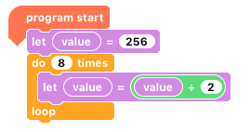
What do these do?
What are the values of the variables?

Slide 4

Code:
Connect the motor to the Crumble.
Connect the battery pack to the Crumble.
Open the Crumble software.
Connect the Crumble to the computer.
Program the motor to turn using a variable called ‘Motor Speed’.

Slide 5
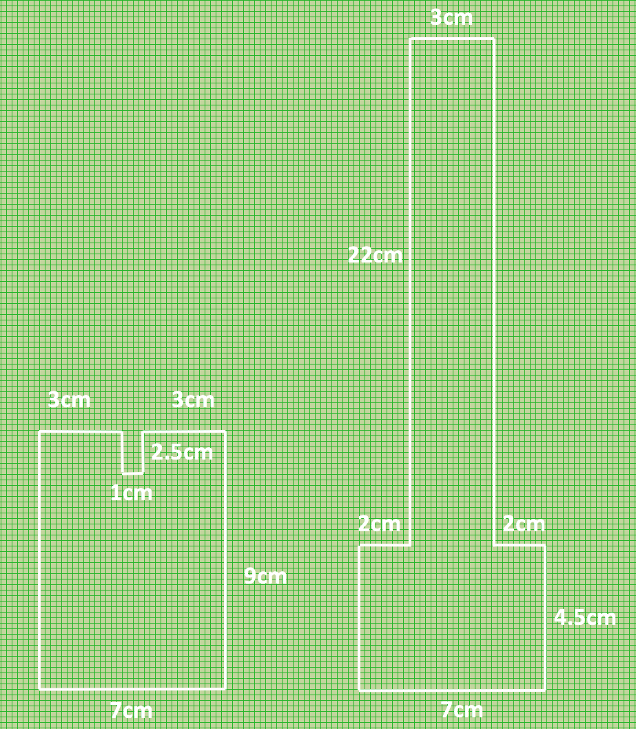
How to make a ‘Spinning Santa’.

Slide 6
Now we want to make our ‘Spinning Santa’ take-off and land…
The motor will gradually speed up and the servo’s angle will gradually increase.
It will then continue at full speed for x amount of time, and then..
The motor will gradually slow down and the angle of the servo will gradually decrease.

Slide 7
Code your ‘Spinning Santa’.
The motor will gradually speed up and the servo’s angle will gradually increase.
It will then continue at full speed for x amount of time, and then..
The motor will gradually slow down and the angle of the servo will gradually decrease.
Variables!
Greater Depth: Can you improve the code? (make it shorter and more efficient?)

Slide 8

Plenary:
Look at your peers’ work. Is it the same/different to yours? Why/why not?
How did those working on GD improve their code?
How do the use of variables make tasks easier? Think about this program without variables…

Slide 9


This work is licensed under the Creative Commons Attribution-NonCommercial-ShareAlike 4.0 International License. To view a copy of this license, visit http://creativecommons.org/licenses/by-nc-sa/4.0/ . For permissions or attribution contact: www.redfernelectronics.co.uk or www.mindsetsonline.co.uk

