Slide 1

LO: To design and program a device to catch Santa
Context: Catch Santa

Slide 2

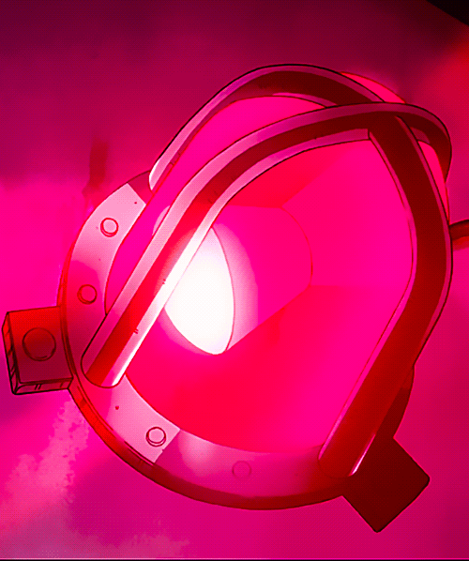
Wouldn’t it be great if…

Slide 3
You are going to Use the Crumble to create an alarm/device to help you catch Santa!
It needs to have some form of ‘trigger’.
This will then set off an audio and/or a visual alert.

Slide 4

Discuss your ideas…
*remember the objectives*
It needs to have some form of ‘trigger’.
This will then set off an audio and/or a visual alert.

Slide 5

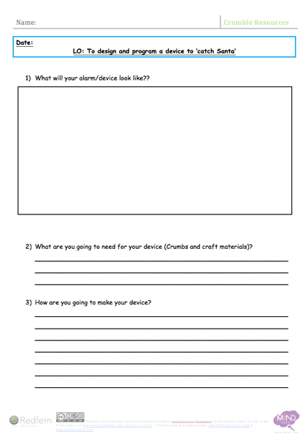
Complete sections 1-3

Slide 6
Now you need to consider how your devices will work.
Write your algorithm (section 4)

Slide 7
Create!

Slide 8
It’s really important to evaluate…
- We can make our work even better.
- Nobody’s ideas are perfect first time!

Slide 9
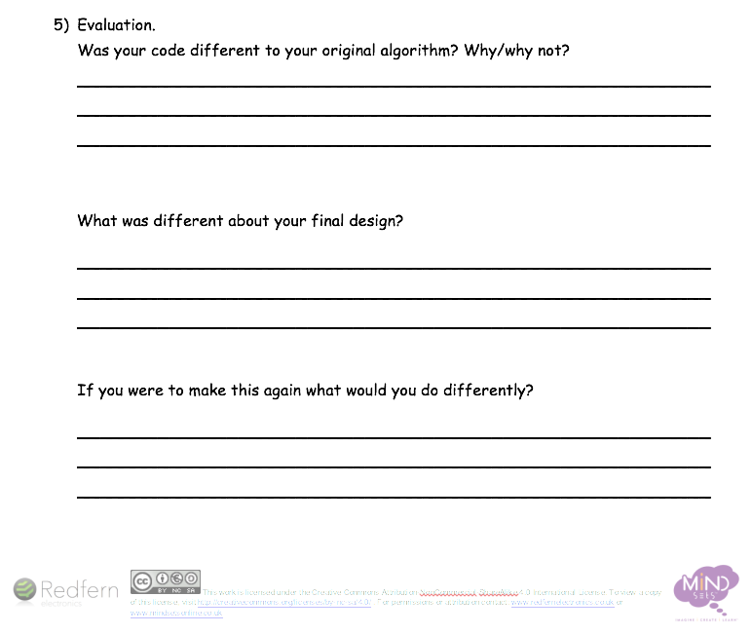
Complete section 5…

Slide 10

Plenary:
Have a look at your peer’s designs. How are they similar or different to yours? How does their code compare?
Discuss: ‘If you were to do this again, what would you do differently and why?
How could this help in the future?

Slide 11


This work is licensed under the Creative Commons Attribution-NonCommercial-ShareAlike 4.0 International License. To view a copy of this license, visit http://creativecommons.org/licenses/by-nc-sa/4.0/ . For permissions or attribution contact: www.redfernelectronics.co.uk or www.mindsetsonline.co.uk

