Slide 1
LO: To make and program a 7-segment display
Context: Make a working 7-segment display

Slide 2

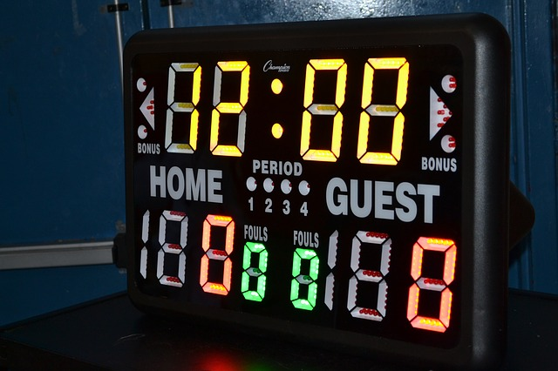
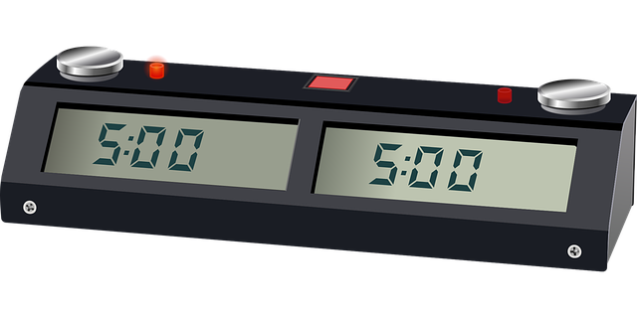
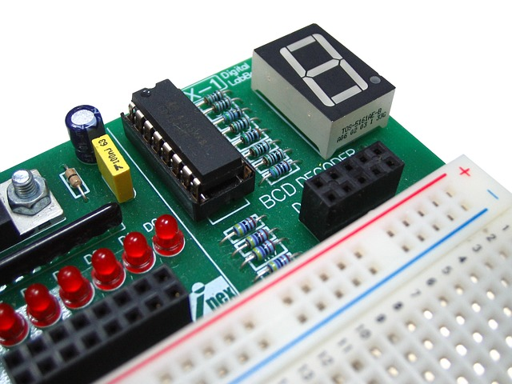
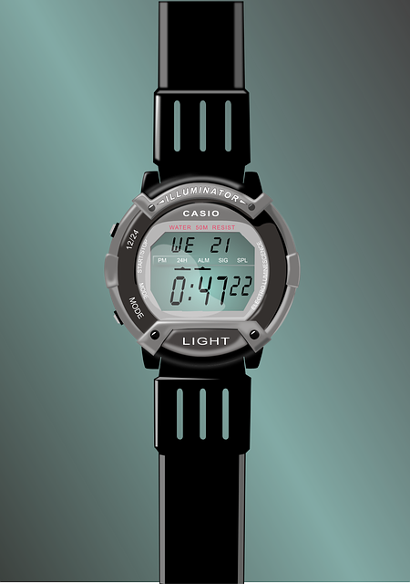
What do these have in common?

Slide 3

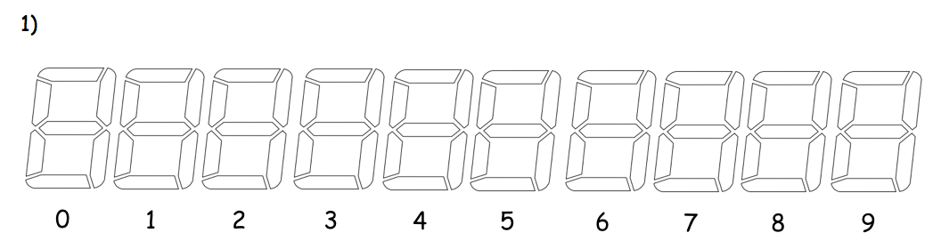
They all use 7 –segment style displays.
It’s a way of representing numbers/information in an easy way. You can make 0-9 using only ‘7 segments’
On your sheet, have a go at making the numbers 0 – 9.

Slide 4
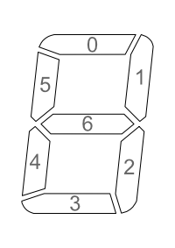
To make this on the Crumble we are going to use 7 Sparkles, one for each segment.
Using the diagram to help, you are going to fill in the table. Lets do this one together:
Number | Sparkle Number
 | 0 | 1 | 2 | 3 | 4 | 5 | 6
Zero
One
Two

Slide 5
Complete the table…
Number | Sparkle Number
 | 0 | 1 | 2 | 3 | 4 | 5 | 6
Zero | On[1] | On[1] | On[1] | On[1] | On[1] | On[1] | Off[0]
One
Two
Three
Four
Five
Six
Seven
Eight
Nine

Slide 6
We need to make our own display, to put the Sparkles into.
Watch and listen carefully…

Slide 7
Make your 7 segment display.
When you’ve finished, you need to wire it up. Use the following diagram to help.
Each number is the Sparkle number.

Slide 8
We are going to program a 9 second countdown timer, using the Crumble software. How will this work?
Discuss the algorithm for lighting up the numbers in sequence.

Slide 9


Algorithm for a countdown

Slide 10
Program your 9 second timer.
Greater Depth: Use a form of input to control and reset the timer

Slide 11

Plenary:
Discuss your solutions to the problem. Does your peer’s program look different/similar to yours? Why do you think this is?
GD: Share using an input to control the timer
What would you do to improve your work?
How could we use this in a future project?

Slide 12


This work is licensed under the Creative Commons Attribution-NonCommercial-ShareAlike 4.0 International License. To view a copy of this license, visit http://creativecommons.org/licenses/by-nc-sa/4.0/ . For permissions or attribution contact: www.redfernelectronics.co.uk or www.mindsetsonline.co.uk

