Slide 1
LO: To use an input and selection to control an output
Context: Use an LDR to control a nightlight

Slide 2

Think about a nightlight.
What is it?
How does it work?
What must it contain?

Slide 3

What would the algorithm for a nightlight be?
Don’t forget the input and output!
Discuss with a neighbouring group - are they similar?

Slide 4
Connect your Crumble and Sparkle Matrix as shown
Watch carefully!

Slide 5

Work through the following:
Can you turn all of the Sparkles blue?

Slide 6
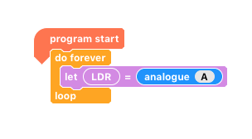
Work through the following:
Connect the LDR to your Crumble and run the following program.
What happens when you cover the LDR? Look at the variable value on you screen.
How do you get the highest number? What about the lowest?

Slide 7
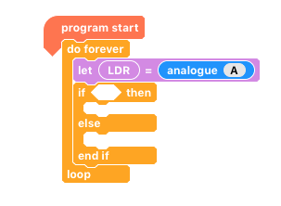
Work through the following:
Can you use the following to help you make your automatic nightlight?

Slide 8
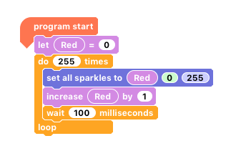
RGB values
Using the RGB values, it is possible to fade from one colour to another.
What will this code do?

Slide 9
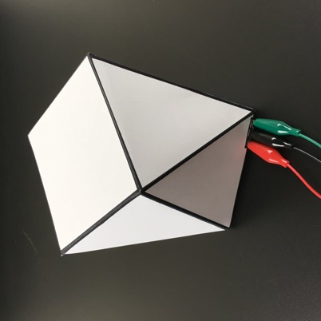
Embed projects into the lamp shades.

Slide 10
Challenge:
Can you make your nightlight cycle through different colours?
Greater Depth: Can you make it fade through different colours?
Hint: you’ll need to check whether it’s light regularly!

Slide 11

Plenary:
What would you do differently next time?
How could you use this project to help you in the future?
How could you take this project further?

Slide 12

This work is licensed under the Creative Commons Attribution-NonCommercial-ShareAlike 4.0 International License. To view a copy of this license, visit http://creativecommons.org/licenses/by-nc-sa/4.0/ . For permissions or attribution contact: www.redfernelectronics.co.uk or www.mindsetsonline.co.uk

