Slide 1
LO: To create automation using inputs and outputs
Context: To create an automatic device

Slide 2

Automation
What is it?
What could it relate to?
Does it look similar to any other words?

Slide 3

Automation, especially within the home is designed to make things easier.
How many examples of automation can you think of?
Example | How it works | Inputs/Outputs

Slide 4

What things in your home could be made easier?
Home Automation Ideas

Slide 5
Planning time
5. What are you going to automate?
How is it going to work?

Slide 6
Planning time 2
5. cont.
What will it look like?
Write an algorithm in pseudocode for your device

Slide 7
Make your creations!

Slide 8
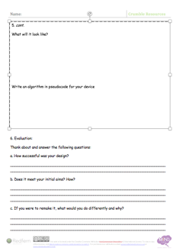
Evaluation:
How successful was your design?
Does it meet your initial aims? How?
If you were to remake it, what would you do differently and why?

Slide 9

Plenary:
What have you learnt from this project, and how will you use it to help you in the future?

Slide 10


This work is licensed under the Creative Commons Attribution-NonCommercial-ShareAlike 4.0 International License. To view a copy of this license, visit http://creativecommons.org/licenses/by-nc-sa/4.0/ . For permissions or attribution contact: www.redfernelectronics.co.uk or www.mindsetsonline.co.uk

