Slide 1
LO: To programmatically control a mechanism
Context: Moving eye picture

Slide 2

What is a moving eye picture?
https://youtu.be/zG3gAnHiiBg?t=42

Slide 3

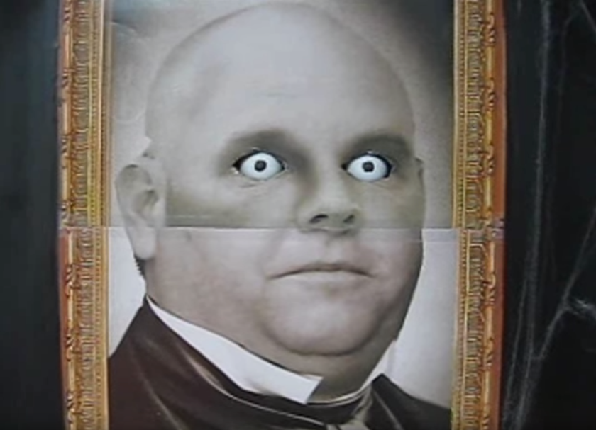
Discuss:
How do you think this would work?
How could you use the Crumble to control it?

Slide 4
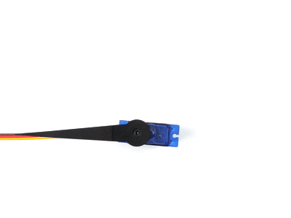
Servo Motor
This is a Servo

Slide 5
Making the picture and frame…
One of the biggest things to watch out for is when attaching the servo – make sure that the arm can move enough (it is possible to incorrectly attach it).

Slide 6

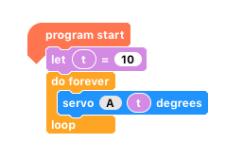
Get the eyes to move from one side to the other.
What is the range of your servo (what angle is it at to look in both directions?
Now use a variable to control the servo.

Slide 7
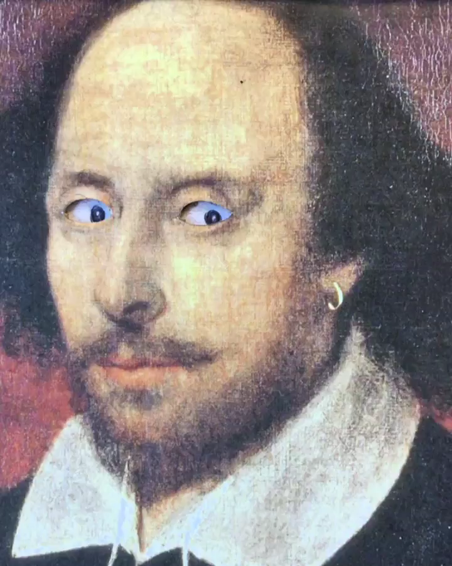
Greater Depth – We want the eyes to move smoothly from one side to the other.
How can we achieve this using variable(s) and as efficiently as possible?

Slide 8

Plenary:
Compare your program/code with a neighbour. Does it look different to yours? Why?
Greater Depth – Explain how you got your program to work.
What would you do to improve your work?
How could you use this in a future project?

Slide 9


This work is licensed under the Creative Commons Attribution-NonCommercial-ShareAlike 4.0 International License. To view a copy of this license, visit http://creativecommons.org/licenses/by-nc-sa/4.0/ . For permissions or attribution contact: www.redfernelectronics.co.uk or www.mindsetsonline.co.uk

